Slide 1
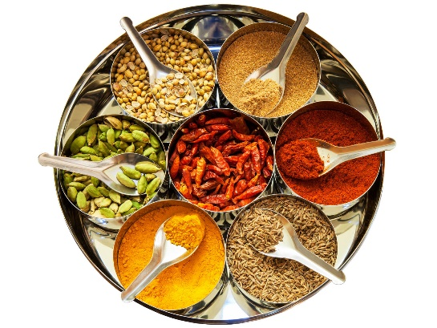
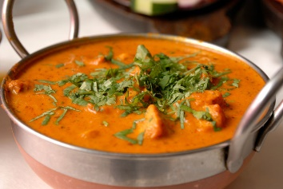
MA PUSHPA’S KITCHEN HOME COOKING DEMONSTRATIONS
WEEK ONE
BUTTER CHICKEN, MINCEMEAT WITH PEAS, AUBERGINE DELIGHT, RAITA AND RICE.
WEEK TWO
PARTY TIME, TANDOORI CHICKEN, ALOO TIKKI, VEGETABLE PAKORA’S, CHICK PEA CHAT & MINT SAUCE.
WEEK 3
SPINACH CHICKEN, PANEER AND PEAS,OMLETTE INDIAN STYLE AND CHAPATTI.
LEARN HOW TO COOK AUTHENTIC INDIAN FOOD AT HOME!
BACK BY POPULAR DEMAND…

Slide 2
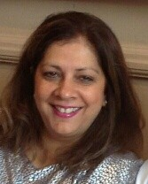
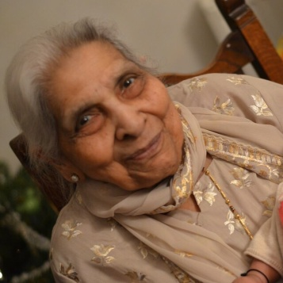
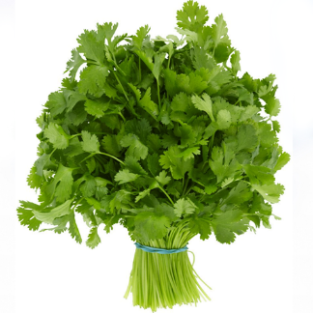
MA PUSHPA’S KITCHEN
BACK BY POPULAR DEMAND…. MA PUSPHPA’S COOKING DEMONSTRATIONS STARTING………
MONDAY 24TH SEPTEMBER 11.30AM
WEDNESDAY 26TH SEPT 6.30 PM
SATURDAY 29th SEPT 11.30 AM
MONDAY 8TH OCT 11.00 AM
WEDNESDAY 10TH OCT 6.30 PM
SATURDAY 13TH OCT 11.30 AM
MONDAY 12TH NOV 11.00A.M
WEDNESDAY 14TH NOV 6.30 PM
SATURDAY 24TH NOV 11.30 AM
PRIVATE CLASSES IN YOUR OWN HOME AVAILABLE TOO
BOOK A COURSE OF THREE CLASSES AND GET FREE CHAPATTI KIT OR SPICE BOX.
PRICE £35.00 PER CLASS
OWN HOME DEMO AND PARTIES AVAI PRICES ON REQUEST.
Why choose Ma Pushpa’s food?
The food I cook has been in our family for centuries. Pushpa my mother, has been cooking since she was about 14. Married at 16. Her life was her family. 5 children and inundated with visitors and relatives she soon became an expert. Relatives in awe of her skills. Her food was simple and delicious. Mum’s food was one you never forget and NOW we get the same reaction from our friends and relatives.
So why have I started these classes? -
Our food is authentic Indian food, cooked from the heart. No recipes followed. Only lessons taught to us with love. Our authentic Indian food, contrary to believe, is not full of chillies but delicately spiced with ingredients that actually have health benefits. Quite different to what you taste in the restaurant and surprisingly not really unhealthy. Her food is now OUR passion. She called it the binding agent of life. No one went home without eating in her house. Her life motto was live for others and keep them happy. Something she did right to the very end.
I will demonstrate in front of you the ease in which you can cook really good food. All food cooked will be authentic Indian food as we eat in our homes. We will talk about the ingredients and spices. After one class you will know how to cook a basic Indian meal. We would like to share these flavours and delights with you and I hope you will enjoy them!!
LEARN TO COOK AUTHENTIC INDIAN FOOD FROM SCRATCH.
BOOKINGS CALL RITA 07956 417035
ritamehra17@hotmail.com
Why chose Ma Pusphas food? The food I cook has been in our family for centuries. Puspha, my mother has been cooking since she was about 14. Married at 16. Her life was her family. 5 children and . t
Notes:
LEARN TO COOK AUTHENTIC FOOD FROM SCRATCH.

